Slide 1
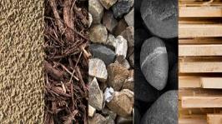
Year 1: Materials Knowledge Mat
Subject Specific Vocabulary |  | Materials for clothes |  | Sticky Knowledge
materials | What something is made of, e.g. wood or plastic. | 1 | Leather – used for shoes, jackets and belts. | 1 | Glass is used for …
wood | The material that comes from a tree. It varies in hardness. |  |  | Windows in houses and cars to see through. Mirrors – to see yourself – reflection.
 |  | 2 | Wool – used for jumpers, socks, pyjamas and coats
plastic | A ‘man-made’ material that can be shaped or moulded to any shape.
 |  | 3 | Cotton – used for clothes we wear on warmer days and shirts.
metal | A tough and strong material which can be heated and shaped into anything. |  |  | 2 | Metal is used for …
 |  | 4 | Silk – expensive material used for scarves and blouses | Strength –in construction of planes, cars and trains and especially tall buildings.
liquid | Liquids can flow and take on the shape of their container.
gas | We can’t see gas but it is all around us. There are different types of gas.
 |  |  |  | 3 | Wood is used for …
stretch | A stretchy material is one that is like elastic. |  |  | Doors – most doors are made from wood. Furniture – most furniture is made of wood, often special wood.
stiff | A stiff material is firm and hard and not flexible.
bend | A bendy material is one that can be twisted and is flexible.
 |  |  |  | 4 | Plastic is moulded or shaped …
waterproof | A material that does not allow water or liquid through.
 |  |  |  | to form any shape from buckets to animal jelly casts.
shiny | A shiny material is sparkly or glossy and sometimes glittery.

Slide 2
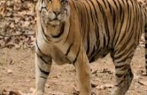
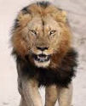
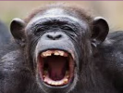
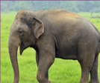
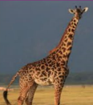
Year 1: Animals Knowledge Mat
Subject Specific Vocabulary |  | Interesting Book | Sticky Knowledge about animals
fish | A fish is a scaly skinned creature with a spine that swims in water and breathes using gills.
 |  |  | The blue whale can produce the loudest sound of any animal.
amphibians | All amphibians begin their life in water with gills and tails. Examples are frogs and newts.
 |  |  | Horses and cows sleep while standing up.
reptiles | Are animals that are cold-blooded. Most lay eggs and their skin is covered with hard, dry scales.
 |  |  | Giant Arctic jellyfish have tentacles that can reach over 36 metres in length.
birds | Birds have feathers and wings. They lay eggs and are warm-blooded animals.
 |  | Wild Animals | Tigers can grow up to a length of 3 metres and weigh up to 300 kilograms when fully developed.
mammals | Mammals are also warm blooded animals. They breath air and have a backbone.
 |  |  | There are about 400 million+ dogs in the entire world. The average life of a dog depending on the breed can vary from 10 to 14 years.
carnivore | A carnivore is a meat-eating animal that gets its food from killing other animals.
herbivore | A herbivore eats plants. |  | Dolphins use whistling, clicking and other sounds to communicate with each other.
omnivore | An omnivore eats plants and meat.
 |  |  | Camels can survive up to six months without water or food due to the fatty tissues stored in their humps.
tame | Domesticated animals that are not frightened of humans and do not try to hurt humans.
wild | Living in the natural environment and not belonging to humans. |  | The cheetah is the fastest animal to roam the earth with top speeds of 113 km per hour.
nocturnal | Animals that are active during the night time.

Slide 3
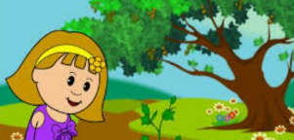
Year 1: Plants Knowledge Mat
Subject Specific Vocabulary |  | Interesting Books | Sticky Knowledge about plants
buds | A small lump on a stem or twig that will grow into a leaf, flower or shoot.
 |  |  | Some trees can live for thousands of years.
bulbs | The resting stage of a plant that is usually formed underground. |  | Some trees can live for thousands of years.
deciduous | Deciduous is the name given to trees that lose their leaves in autumn and are bare in the winter.
 |  |  | Around 2000 different types of plants are used by humans to make food.
 |  |  | Some plants are carnivores. A well known example of a carnivorous plant is the Venus Flytrap.
evergreen | Evergreen is the name of trees that have leaves all year round.
trunk | A tree's trunk holds up its crown, protects its inner parts and works like a pipeline, transporting essential materials to the different parts of the tree. | Important facts to know by the end of the plants topic: | Bamboo can be a fast growing plant. Some types can grow almost a metre in just one day!
 |  |  | Touching poison ivy will cause an allergic reaction, usually in the form of an itchy rash on the skin.
vegetable | A vegetable is a plant or part of a plant which is used as food, for example cabbage or potato.
 |  | Know the names of a variety of common wild and garden plants Know the names of a variety of common trees Know the difference between deciduous and evergreen trees Know which plants grow in the local environment | As well as looking beautiful, trees help purify the air and provide food and shelter for all sorts of creatures.
wild plants | These are plants that don’t grow in our gardens and are self-seeded. |  | As well as looking beautiful, trees help purify the air and provide food and shelter for all sorts of creatures.
 |  |  | Water and nutrients travel up the tree trunk, through the branches and all the way out to the leaves.
environment | The area where a plant or tree lives is its environment. |  | Water and nutrients travel up the tree trunk, through the branches and all the way out to the leaves.
blossom | Blossom is the flower that comes before the fruit. For example, apple blossom comes before the apple starts to grow.
petals | A petal is a part of the flower and is usually coloured. The colour attracts insects.
branches | Branches come from the tree trunk and grow outwards.

Slide 4
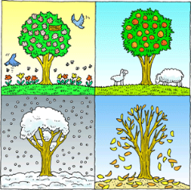
Year 1: Seasonal Change Knowledge Mat
Subject Specific Vocabulary |  | Interesting Book | Sticky Knowledge about seasonal change
Autumn | The time of year between September and November. Many leaves fall off the trees.
Spring | The time of year between March and May. There is usually lots of signs of new growth in Spring.
 |  |  | In the UK we have four seasons: spring, summer, autumn and winter. Summer is the hottest season and winter the coldest.
Summer | The hottest season in the UK. It happens between June and August. The longest day is June 21st.
 |  |  | Spring starts when the day and night are the same length (usually 21st March. However, many say that Spring starts on March 1^{st)}.
Winter | The coldest season in the UK. We can have snow in this season. It occurs between December and February.
Fall | The name given to the Autumn season by Americans. It is because so many leaves fall off the trees.
 |  |  | In summer the longest day of the year is around June 21st and in winter the shortest day of the year is usually December 21st.
weather | Weather is what the sky and the air outside are like, such as cold and cloudy.
temperature | It is measurement of hot or cold that can be measured using a thermometer.
 |  |  | When we have our summer it is winter in the southern hemisphere. When we have our winter Australia has its summer.
thermometer | This is the instrument that measures the temperature.
weather symbol | These are signs used to help us understand more about our daily weather. |  | In the USA and many other countries the season ‘Autumn’ is known as the ‘Fall’. This is because so many leaves fall from the trees in Autumn.
deciduous | Deciduous trees are trees that shed their leaves once a year, usually during the season of autumn.
coniferous | Most conifers are evergreens, or trees that keep their leaves year-round. |  | Seasons change throughout the year because of the way the Earth travels around the Sun.

Slide 5
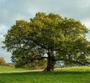
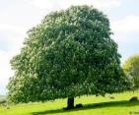
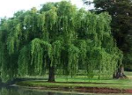
Year 2: Plants and Trees Knowledge Mat
Subject Specific Vocabulary |  | Interesting Books | Sticky Knowledge about trees
roots | It is the part of a plant that is usually hidden under the ground. They make the plant stable and give it nutrients.
 |  |  | Trees and shrubs take in water and carbon dioxide and give out oxygen.
crown | The crown is made up of the leaves and branches at the top of the tree.
deciduous | Deciduous trees are trees that shed their leaves in the Autumn and grow new leaves in the spring. |  | Trees can live for a very long time. The oldest known tree is over 5000 years old.
evergreen | Evergreen trees are the same as coniferous trees. They do not lose their leaves in Autumn.
 |  | Common trees found in the UK | A single tree has many roots. The roots carry food and water from the ground through the trunk and branches to the leaves of the tree.
blossom | Is the mass of flowers created by a tree. Almost all fruit bearing trees have blossom. The blossom is usually at its best in the spring.
bulb | Bulbs are underground masses of food storage from which plants grow.
 |  |  | The trunk is the main body of the tree. The trunk is covered with bark which protects it from damage.
trunk | A tree's trunk holds up its crown, protects its inner parts and works like a pipeline, transporting essential materials to the different parts of the tree.
 |  |  | The leaves can be of many different shapes. They take in sunlight and use water and food from the roots to make the tree grow.
stem | The stem is the main part of the plant. It supports the weight of the leaves, as well as the flowers or fruit.
woodland | A woodland is a habitat where trees are the dominant plant form.
habitat | The place where a plant or animal (mostly) lives. There are different kinds of habitats, such as grassland, forest, river, sea and desert. |  | As a tree grows, it usually produces growth rings as new wood is laid down around the old wood.
oxygen | Oxygen is used by animals and plants in the respiration (breathing) process.
oak
Horse chestnut
conifer
willow

